Slide 1

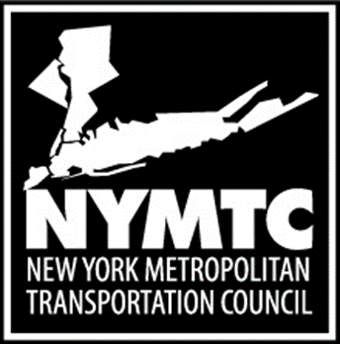
Clean Freight Corridors Planning Study
Committee on Intermodal Freight Transport & International Trade and Transportation
Mid-Year Meeting – June 15, 2020

Slide 2
Study Objective
The objective of this study is to assess opportunities for the development of Clean Freight Corridors in the NYMTC planning area that are integrated within the larger Multi-State Metropolitan Region. This study will:
  Inventory existing alternative fuel infrastructure in the region;
  Review current and emerging alternative fuel technologies;
  Identify gaps between existing and future alternative fuel infrastructure capacities;
  Analyze goods movement trends and forecasts;
  Identify and define optimal corridors for recommended designations as clean freight corridors and identify needs for the development of additional clean freight infrastructure in each corridor.

Slide 3
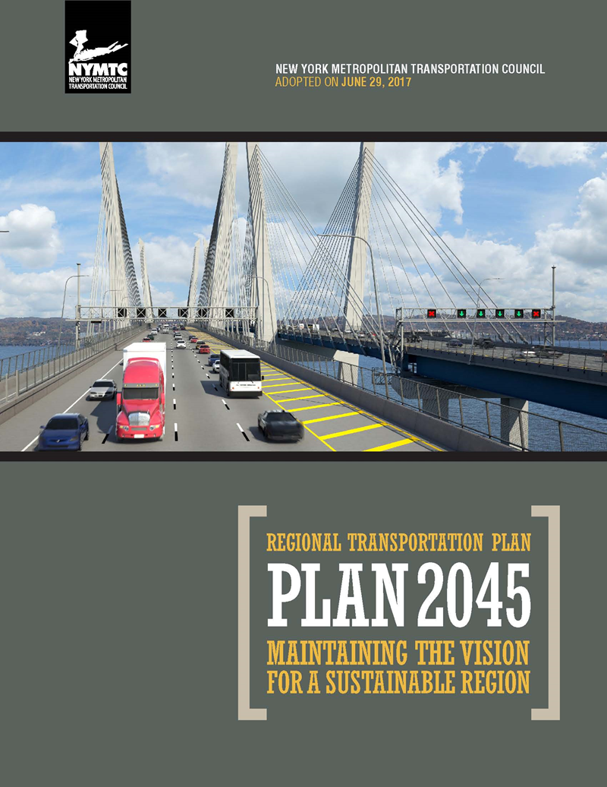
NYMTC’s Current Regional Transportation Plan - adopted June 29, 2017
Notes:
As required, Plan 2045 is multi-modal; therefore, goods movement is a required and significant component of the plan.
The Regional Freight element is Appendix 8 to the plan. It is both an appendix and a standalone Regional Freight Plan.

Slide 4
Study Context
Clean Freight Corridors Planning Study

Slide 5
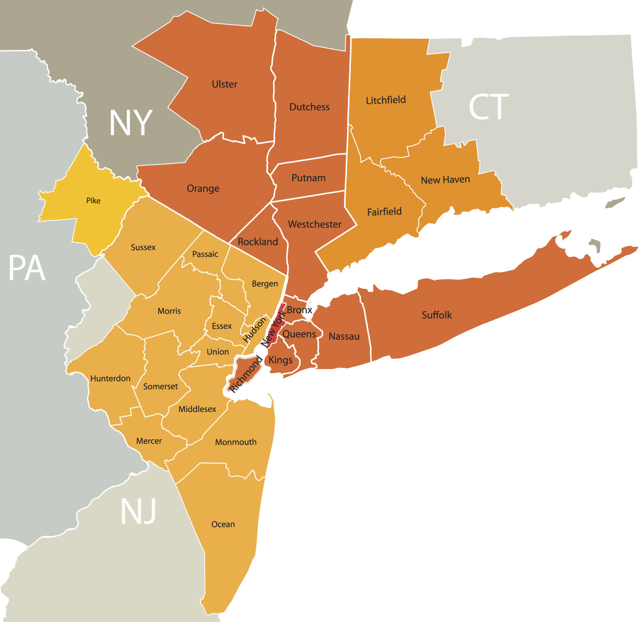
A large, complex multi-state region . . .
Notes:
The Combined Statistical Area encompasses 35 counties in four states and nearly 24 million people
In 2015, the CSA had a GDP of $1.83 trillion, which would rank 8th among countries

Slide 6
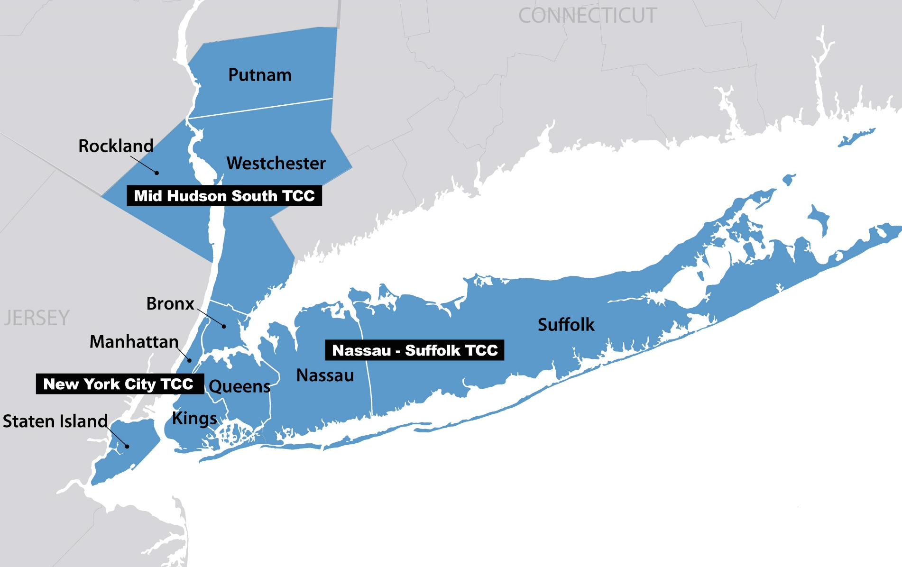

PLANNING AREA

Slide 7
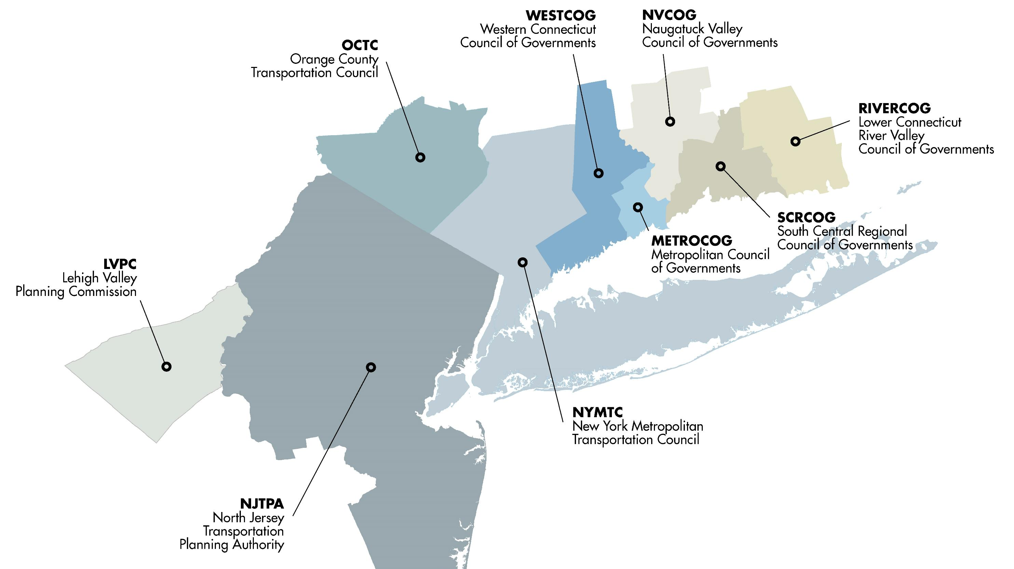
Multi-state consortium

Slide 8
Complex multi-state commodity flows . . .

Slide 9
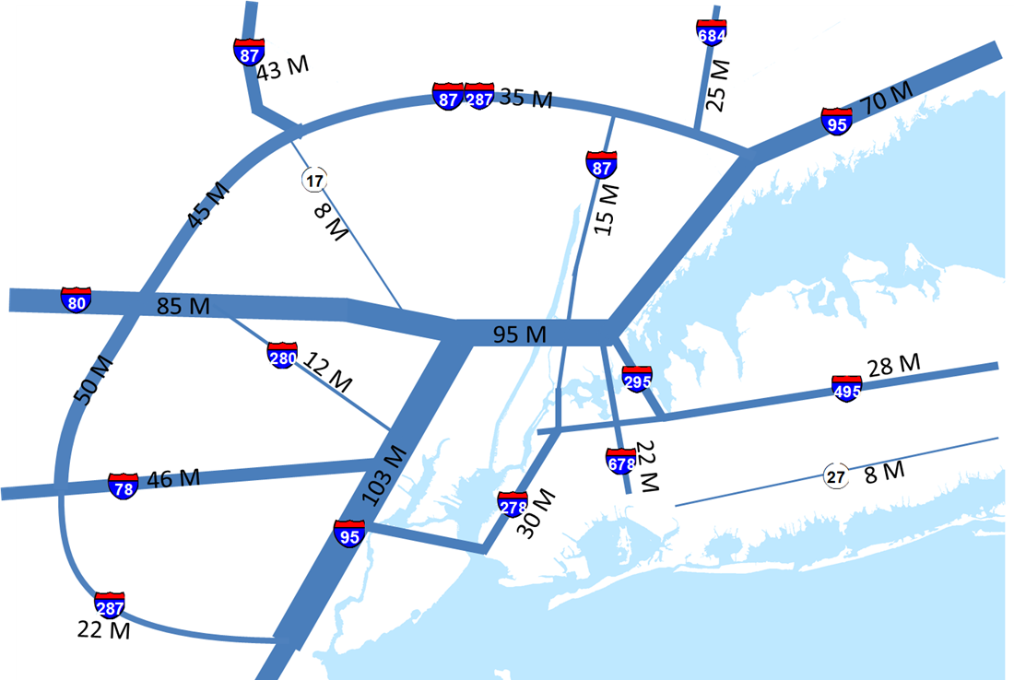
Major freight volumes in highway corridors . . .
(annual tonnage shown)
Notes:
The roadway system bears the majority of the goods movement burden.
The already congested limited access roadway system therefore serves as the primary system for goods movement.

Slide 10
Multiplicity of truck trip purposes . . .
Notes:
Given the region’s size, complexity, topography and location in the Northeast megaregion, there is a diversity of truck trip purposes on the roadway network

Slide 11
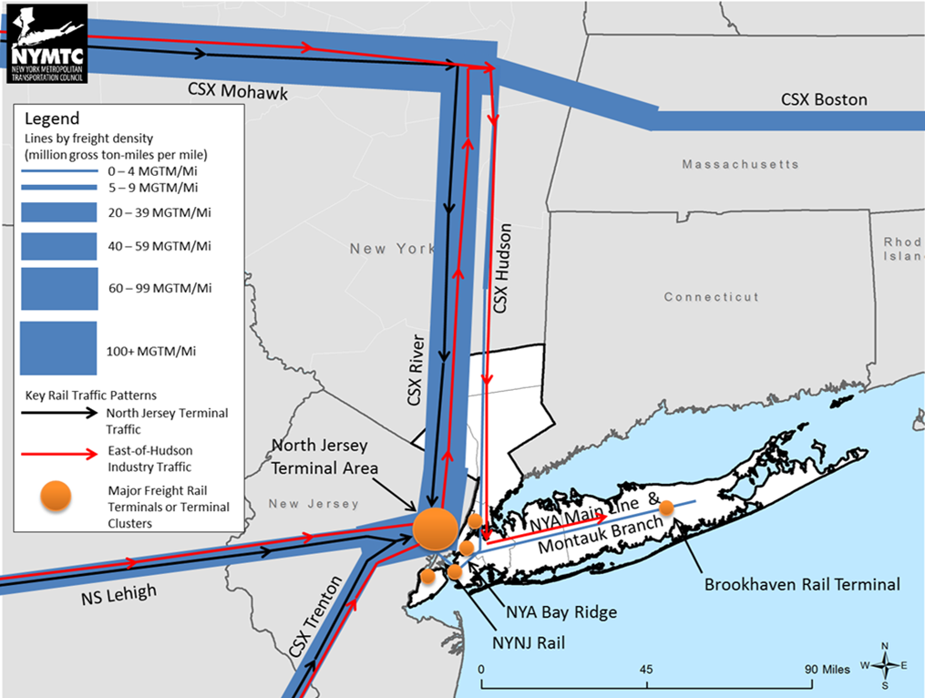
Freight rail limitations
Notes:
Rail freight does not realize its full potential and volumes are both constrained and shaped by available facilities and missing links in the system.

Slide 12
Geographic imbalance of multimodal facilities . . .
Notes:
The locations of multi-modal facilities generally reflect the characteristics of both the region and of the goods movement system
Note the concentration of rail & truck facilities in northern New Jersey, along with major port facilities

Slide 13
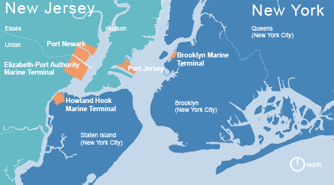
Major port facilities . . .
Notes:
Finally, the presence of a very large port in the multi-state metropolitan region is itself a challenge.
Changes in the size and capacity of container ships calling at the port facilities have added and will continue to add demand to the system.
Transportation access to these facilities is problematic at present.

Slide 14
GROWING GOODS MOVEMENT
Source: 2012 IHS Global Insight Transearch Data, 2012 Surface Transportation Board (STB) Waybill Sample

Slide 15
Scope of Work
Task 1. Project Coordination and Public Information Materials
Task 2. Regional Assessment for Clean Freight Corridors
Task 3. Clean Fuel Technologies Scan and Projections
Task 4. Analyze Trends and Forecasts
Task 5. Assess and identify optimal mix of new clean freight corridors, including public involvement

Slide 16
Task 1
Project Coordination and Public Information Materials
Project Coordination
Project management calls
SSC and TAC meetings
Public Information Materials
Project overview document
Graphics/materials for social media describing the project

Slide 17
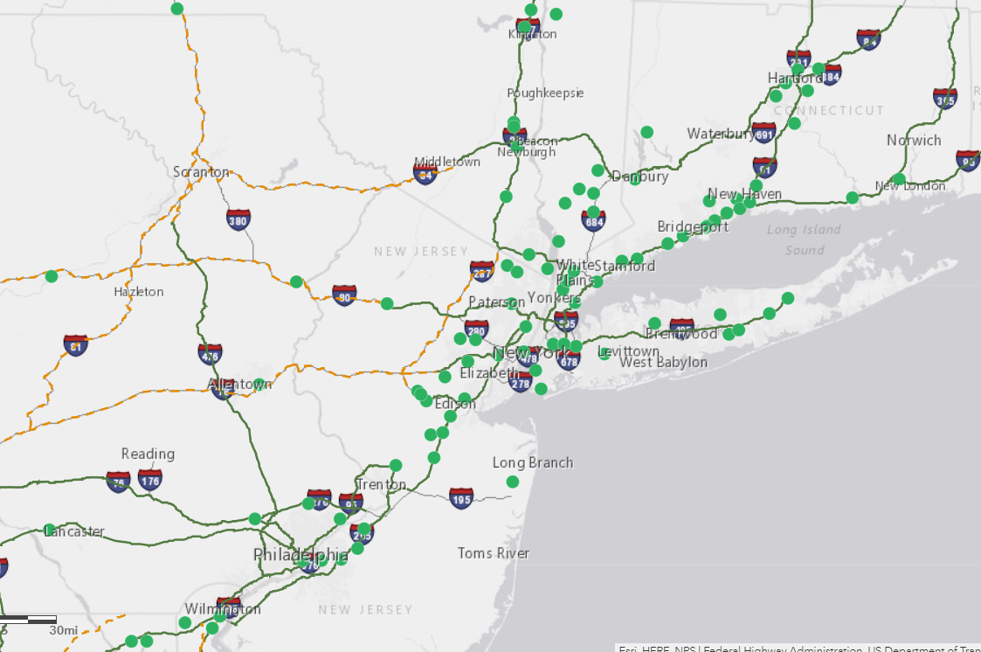
Task 2
Regional Assessment for Clean Freight Corridors
Identify existing alternative fuel infrastructure and FHWA corridor designations: EV, hydrogen, natural gas, and propane
Develop a Regional Assessment of Clean Freight Corridors
  Assessment of existing alternative fuel stations (including compatibility with freight vehicles)
  State-by-state AFC designation status
  Gap analysis for “corridor-pending” areas
US Department of Energy, Alternative Fuels Data Center, Potential Corridor Interactive Map (EV charging): https://afdc.energy.gov/corridors

Slide 18
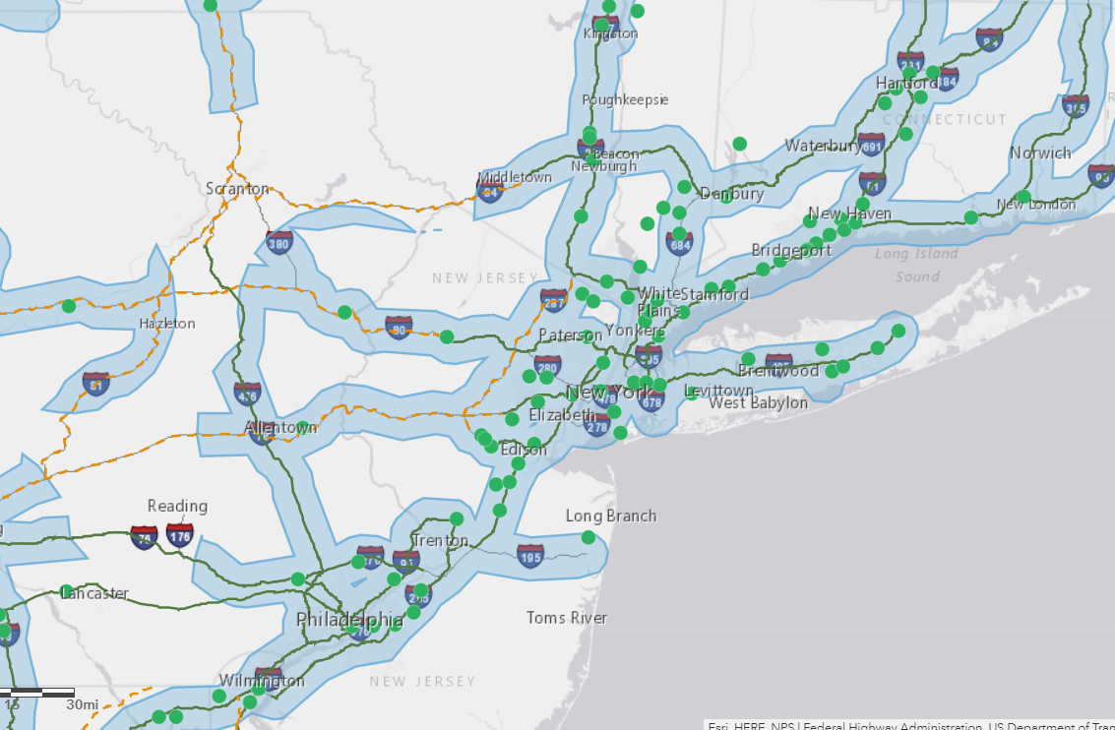
Task 3
Clean Fuel Technologies Scan and Projections
Conduct clean fuels technology scan and projections
Evaluate alternative fuel technology and infrastructure regulatory landscape
Develop visual gap analysis for alternative fuel infrastructure
  Will account for infrastructure identified in Task 2 as well as credible in-development projects
Construct geospatial representation of potential new corridor designations
US Department of Energy, Alternative Fuels Data Center, Potential Corridor Interactive Map (EV charging): https://afdc.energy.gov/corridors

Slide 19
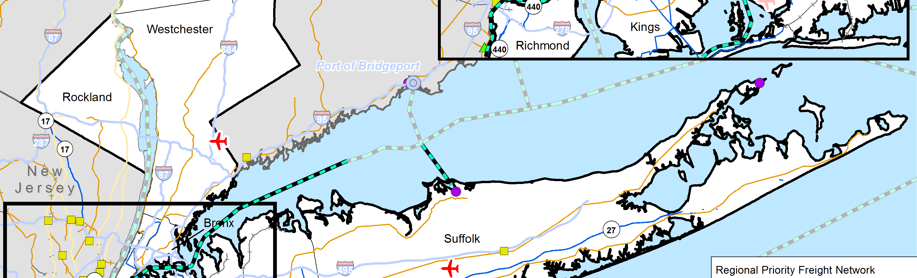
Task 4
Analyze Trends and Forecasts
Review/refresh commodity flow patterns
Inventory/map existing freight hubs and economic development/opportunity areas
Identify/map freight corridor and network designations (federal, state and regional)

Slide 20
Task 5
Assess and identify optimal mix of new clean freight corridors, including public involvement
Prepare materials for, and complete, public workshops
Assess and identify optimal mix of new corridors for designation
Define steps needed for developing additional infrastructure

Slide 21

Questions?

