Slide 1
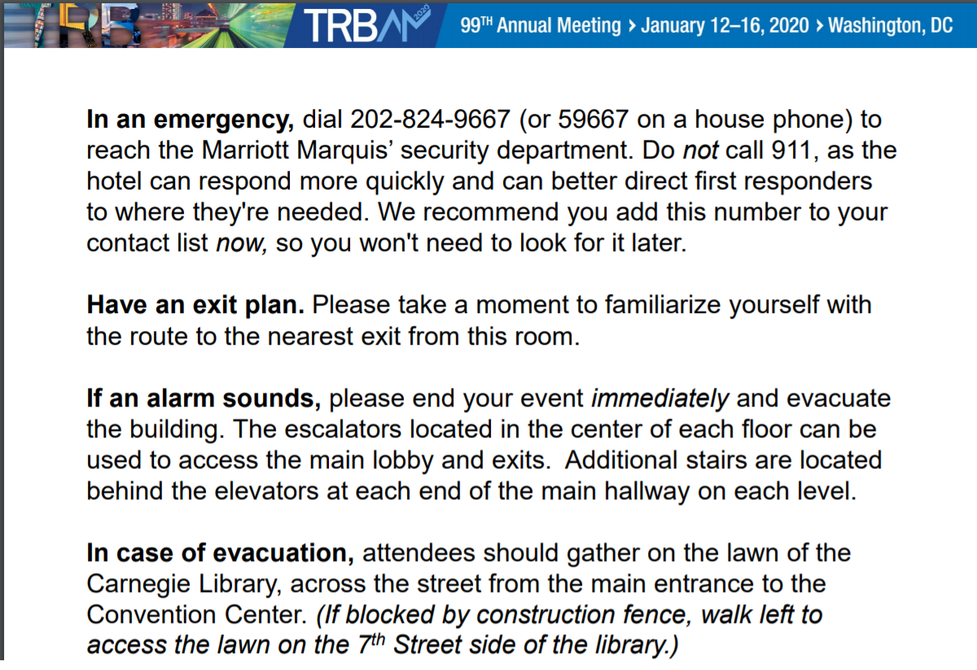

Slide 2
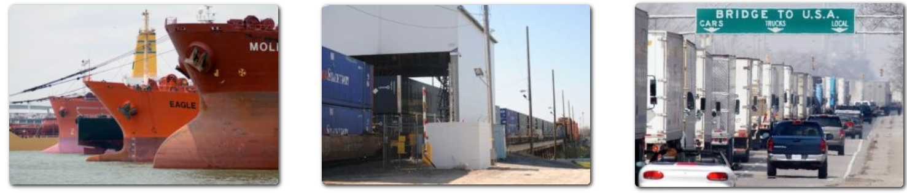
Transportation Research Board
International Trade and Transportation (AT020)
Annual Conference Meeting
January 13, 2020

Slide 3
Meeting Agenda
Welcome and Introductions (Juan Carlos Villa) 3:45-3:50
TRB Staff Report (Scott Brotemarkle) 3:50-4:00
Committee Business
  Meeting minutes (Steven Beningo) 4:00-4:05
  Research Coordinator (Daniel Hackett) 4:05-4:15
  Mid-Year Meeting (Juan Carlos Villa) 4:15-4:20
  Committee Rotation (Juan Carlos Villa) 4:20-4:25
  Economy and Trade Subcommittee (Michael Bomba) 4:25-4:30
AT020 International Trade and Transportation

Slide 4
Meeting Agenda
Special Guests Presentations 4:30-5:20
“30‐second” Announcements 5:20-5:25
Certificates of Appreciation and Group Photo (Members) 5:25‐5:30
Adapting to New Definitions of Globalization (Andrea Durkin, Center for Strategic and International Studies)
Panama Canal Performance and Water Resources Management (Ricaurte Vásquez-Morales, Panama Canal Authority)
Trade Agreements of the New Generation (Maximilian Bauernfeind, Austrian Ministry of Innovation,Transport and Technology)
AT020 International Trade and Transportation

Slide 5
Welcome and Introductions
New Members:
Ricaurte Vásquez, Panama canal
Timoteo Juarez, TxDOT
Jose Marquez-Chavez, Caltrans
Eleftherios Sdoukopoulos, University of Piraeus
AT020 International Trade and Transportation

Slide 6
Committee Business
  Meeting minutes
  Research Coordinator Report
    The Risks to Global Trade
    The Relationship between Investments in U.S. Transportation Infrastructure and Competitiveness of U.S. Exports
    Logistics Infrastructure Measurement and Prioritization Protocol: Ensuring Trade Drives Economic Growth
  Funding alteranative ideas?
AT020 International Trade and Transportation

Slide 7
Committee Business
Mid-Year Meeting
  Option 1
Washington D.C. In conjunction with the Marine and Freight Committee Meetings – June 15, 020. Sixth Biennial Marine Transportation System Innovative Science and Technology Conference
Option 2
  May 28th (the day after the Canadian Transportation Research Forum (CTRF) meeting in Montreal in Massena, New York home of the Saint Lawrence Seaway Development Corporation.
AT020 International Trade and Transportation

Slide 8
Committee Business
Committee Rotation
  Every three years, there must be a rotation of each TRB Standing Committee’s membership.
  Basic requirements
    rotate off one third of the committee’s members; and
    appoint new members to the committee.
  Due February 15, 2020
Economy and Trade Subcommittee
AT020 International Trade and Transportation

Slide 9
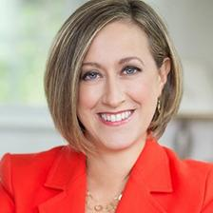
Special Guests Presentations
Adapting to New Definitions of Globalization
Andrea Durkin, Adjunct Fellow (Non-Resident), Scholl Chair in International Business, Center for Strategic and International Studies
Editor-in-chief of CSIS’s TradeVistas website, a non-resident senior fellow at the Chicago Council on Global Affairs, and founder of Sparkplug, LLC. She is also a contributing writer to policy think tanks and foundations on trade and development issues.
From 2006 to 2013, Ms. Durkin served as senior director for global government affairs in the Washington, D.C., office of Abbott Laboratories. She previously served as a U.S. government trade negotiator and teaches international trade as an adjunct associate professor in Georgetown University’s Master of Science in Foreign Service program. Ms. Durkin holds a B.A. in international economic relations from the University of Michigan and an M.S. from the School of Foreign Service at Georgetown University
AT020 International Trade and Transportation

Slide 10
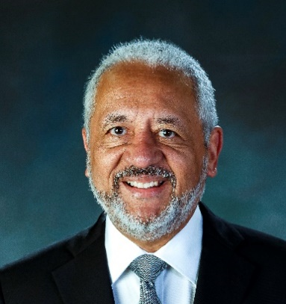
Special Guests Presentations
Panama Canal Performance and Water Resources Management
Ricaurte Vásquez Morales, Administrator of the Panama Canal
Dr. Vásquez has a broad and successful career of more than 30 years in financial management, international capital markets, financial consulting and extensive experience in the public sector. Within the Panama Canal, Dr. Vásquez was the first Panamanian Finance Director at the waterway from 1996 to 2000.
He also served as Deputy Administrator from 2000 to 2004 and Minister for Canal Affairs and Chairman of the Board of Directors from 2004 to 2006. He was responsible for the financial transition of the Canal to Panamanian Administration. Dr. Vásquez has a BS in Mathematics from Villanova University, a MS in Operations Research and Statistics and a Ph.D. in Managerial Economics, from the Rensselaer Polytechnic Institute, and a Master's in Economics from North Carolina State University.
AT020 International Trade and Transportation

Slide 11
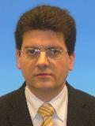
Special Guests Presentations
Trade Agreements of the New Generation
Maximilian Bauernfeind, Austrian Ministry of Innovation,Transport and Technology
Maximilian has more than a decade of experience transport policy at the national, European and international levels, working for the Austrian Ministry for Transport, in the European Commission's DG for Mobility and Transport (MOVE) and the European Maritime Safety Agency (EMSA) since 2003.
He has participated in very diverse fields, such as inland waterway, maritime transport, environmental protection, trade policy, and its implications on transport.
Maximilian is a lawyer by education, holding a degree by the University of Vienna
AT020 International Trade and Transportation

Slide 12
Closing remarks
Members’ 30‐second Announcements
Certificates of Appreciation
Group Photo (Members)
Thanks for Volunteering!
Visit: https://www.trbtradetransportation.org/
Contact me @ Juan Carlos Villa, J-villa@tamu.edu, 979-317-2471
AT020 International Trade and Transportation

