Slide 1
Transportation Research Board
International Trade and Transportation (AT020)
Pre-Annual Conference Meeting
December 3, 2018

Slide 2
Meeting Agenda
Welcome, Introductions and Meeting’s Objective
Mid-year and Annual Minutes Steven Beningo
Paper Review Chair Isabel Victoria
Research Coordinator Daniel Hackett
Communications Coordinator Irina Benedyk
Strategic Plan Update Juan C. Villa
Mid-Year Meeting All
Annual Meeting Juan C. Villa
Comments All
AT020 International Trade and Transportation

Slide 3
Welcome, Introductions, and Meeting’s Objective
Please provide name, affiliation and area of interest
  New members
  Members and friends update
Meeting Objective:
Discuss Committee Business and finalize plans for Annual Meeting and future activities.
AT020 International Trade and Transportation

Slide 4
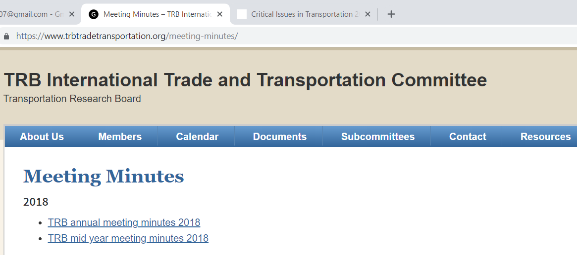
Meeting Minutes
Steve Beningo, Secretary
  Minutes located at: https://www.trbtradetransportation.org/meeting-minutes/
AT020 International Trade and Transportation

Slide 5
Paper Review
Isabel Victoria, Paper Review Coordinator
AT020 – Reviewer Pool
Reviewer Pool = 219 names
Reviewer Pool with failure emails = 26 (reported to TRB)
Reviewers available to review AT020 Papers = 29
  Included 16 AT020 Members
  Papers assigned based on detailed areas of expertise provided by reviewers
AT020 International Trade and Transportation

Slide 6

Paper Review
Areas of Expertise of Available Reviewers (Sample)
International trade
International seaborne trade
Liner shipping; Liner operations; Competition policy in liner shipping
Maritime transportation
Container shipping
Port performance
Port strategic management and short sea shipping
Cross-border freight movements by truck and rail
Operations research; Optimization; Simulation modeling; Mathematical programming; Metaheuristics; Evolutionary computation
Connected vehicle environments for freight
Trade modeling (freight transport network models; econometric models)
Freight transport (trucking, rail, maritime)
Freight performance measures
AT020 International Trade and Transportation

Slide 7
Paper Review
Areas of Expertise of Available Reviewers (Sample)
Evolution and management of global supply chains
Maritime transport networks and short sea shipping
Port and terminal operations; Port-hinterland networks / corridors and logistics; Port-city interactions
International commodity trade forecasting and market analysis
Ports of Entry/Exit and trade market analysis
Air, maritime, rail and truck-specific trade studies
International trade data collection, use, fusion, applications, programs, and policy
Foreign economic policy, particularly trade and investment;
International transportation policy, although mostly focused on air transport;
Financing and permitting;
Economics and finance
Transport economics
Maritime economics
Economics of international trade and shipping
AT020 International Trade and Transportation

Slide 8
Paper Review
2018 Paper Reviewers
Reviewers | Reviewers
1. Ahmadreza Talebian (2 papers) | 12. Juan Carlos Villa*
2. Chris Bachmann (2 papers) | 13. Marc Levinson*
3. Daniel A. Hackett* | 14. Mary R. Brooks* (2 papers)
4. Eleftherios Sdoukopoulos | 15. Matthew Rooney*
5. Elisa M. Arias* | 16. Maxim A. Dulebenets* (4 papers)
6. Emily Hashimoto* | 17. Meifeng Luo
7. Ghim Ping Ong* | 18. Paul H. Bingham* (2 papers)
8. Irina Benedyk* | 19. Philip Stephen Davies
9. Isabel C. Victoria-Jaramillo* | 20. Steven Paul Beningo*
10. James F. Nolan | 21. Taqhiuddin Mohammed (2 papers)
11. Jason J. Bittner | 22. Verena Charlotte Ehrler
AT020 International Trade and Transportation

Slide 9
Paper Review
Papers Submitted for Presentation, Publication or Both
Paper Number | Article Type | Paper Title | Reviewer Avg. for Presentation | Reviewer Avg. for Publication | AT020 Recommendation
19-00323 | Publication & Presentation | Trade Cluster Impacts on USA Southern Border Transportation Costs | 4.0 | 3.0 | Podium Presentation Publication (subject to outcomes of second review round)
19-01207 | Publication & Presentation | Optimizing Canada-us Border Crossing Investments for Export Competitiveness | 4.2 | 3.17 | Podium Presentation Publication (subject to outcomes of second review round)
19-05740 | Presentation Only | Machine Learning Based Short-term Wait Time Prediction Model For US-Mexico Border Crossing | 4.25 | N/A | Podium Presentation
19-03191 | Presentation Only | Liner Shipping Routes and Schedules under Uncertain Weather and Ocean Conditions: A Robust Optimization Approach | 4.0 | N/A | Poster Presentation
19-00464 | Presentation Only | A Critical Review of the Literature on Vessel Scheduling in Liner Shipping | 2.5 | N/A | Not recommended for presentation
19-03893 | Publication & Presentation | Which New Silk Road? An Evaluation of the Economic Geography of Russia and Kazakhstan in Relation to Proposed Eurasian Rail Corridors | 2.75 | 1.67 | Not recommended for publication or presentation
AT020 International Trade and Transportation

Slide 10
Paper Review
Papers Submitted for Presentation, Publication or Both
Poster Session 1238
Liner Shipping Routes and Schedules Under Uncertain Conditions
Monday 1/14/2019, 10:15 AM – 12:00 PM
Convection Center, Hall A
Sponsored by AT020
Paper Number | Paper Title
19-03191 | Liner Shipping Routes and Schedules under Uncertain Weather and Ocean Conditions: A Robust Optimization Approach
AT020 International Trade and Transportation

Slide 11
Paper Review
Papers Submitted for Presentation, Publication or Both
Lecter Session 1686
Cross-Border Costs, Investment Optimization, and Wait Time Predictions
Wed 1/16/2019, 8:00 AM – 9:45 AM
144B, Convection Center
Sponsored by AT020
Paper Number | Paper Title
19-00323 | Trade Cluster Impacts on USA Southern Border Transportation Costs
19-01207 | Optimizing Canada-us Border Crossing Investments for Export Competitiveness
19-05740 | Machine Learning Based Short-term Wait Time Prediction Model For US-Mexico Border Crossing
AT020 International Trade and Transportation

Slide 12
Paper Review
Comments and remarks
Good match between reviewers and papers
  No papers were rejected by reviewers
  A better listing of areas of expertise made the difference
Declined trend in the number of paper submitted
  6 papers in 2018 (compared to 10 papers in 2017)
  What we can do to attract more papers?
Thanks again to all the 22 reviewers for your continued support to the paper review process
AT020 International Trade and Transportation

Slide 13
Research Coordinator
Daniel Hackett
Status report
AT020 International Trade and Transportation

Slide 14
Communications Coordinator
Irina Benedyk birina@purdue.edu
Web-site:
Update committee members information.
Update committee calendar (including TRB events).
Presentations and minutes from last meeting are on web-site as well.
Other communication:
LinkedIn page update.
Twitter ?
AT020 International Trade and Transportation

Slide 15
Triennial Strategic Plan Update
Previous plan was updated in 2017
International Trade and Transportation conditions have changed, bringing new challenges
New technological advances have emerged that require a new look to our plan
TRB published the “Critical Issues in Transportation Report” with a series of challenging questions are posed to explore issues and opportunities that may arise 10 to 20 years into the future.
Need volunteers to work with me to update the TSP
AT020 International Trade and Transportation

Slide 16
Mid-Year Meeting
OPTION 1
In conjunction with the Innovations in Freight Data Workshop
April 8-10, 2019, Beckman Conference Center. Irvine, California
Committees have the option of meeting the day before the following program on Monday April 8.
OPTION 2
Mid-Year Meetings, Day of Plenary Sessions, and Port Tour Opportunity – Galveston TX – Probable time frame: during first two weeks of June.
We would need a critical mass of interest from committees to pursue.
OTHER OPTIONS??
AT020 International Trade and Transportation

Slide 17
Annual Meeting
Spend more time discussing strategic topics of interest to the International Trade and Transportation Committee
Identify research ideas and develop a plan to move those selected ideas to the next level
Potential topics for discussion:
  Impact of current international trade relations in the transportation system
  Chinese One Belt One Road initiative
  Impacts of 2020 International Maritime Organization’s (IMO) bunker regulations in international trade
  Other?
Identify volunteers for a very brief presentation on selected topics
Identify interest from Annual Meeting participants in each topic
Define breakout groups for each topic
AT020 International Trade and Transportation

Slide 18
Thanks for Volunteering
Juan Carlos Villa
J-villa@tamu.edu
979-862-3382
AT020 International Trade and Transportation

